Slide 1
PROJECT TITLE
CAPSTONE PROJECT
Presented By:
Logeshwaran .A
University College Of Engineering Kanchipuram
Mechanical

Slide 2
OUTLINE
Problem Statement
Proposed System/Solution
System Development Approach
Algorithm & Deployment
Result
Conclusion
Future Scope
References

Slide 3
Problem Statement
There is a pressing need to develop a robust movie review aggregator that addresses these shortcomings and provides users with a seamless experience for discovering, evaluating, and engaging with movie reviews.
Data Integration: Collecting and integrating reviews from diverse sources including professional critics, user-generated content, and social media platforms while ensuring accuracy and relevance.
Sentiment Analysis: Implementing advanced sentiment analysis techniques to accurately gauge the overall sentiment of reviews, considering nuances such as sarcasm, irony, and context.
Real-time Updates: Ensuring timely updates of reviews as new movies are released and existing ones garner additional reviews, providing users with the most up-to-date information.
User Interface Design: Designing an intuitive and visually appealing user interface that enhances the user experience, facilitates easy navigation, and encourages user engagement.
Personalization: Incorporating features for personalized recommendations based on user preferences, viewing history, and demographic information to enhance user satisfaction and retention.
Quality Assurance: Implementing robust quality assurance measures to mitigate errors in data processing, sentiment analysis, and user interface functionality.
Legal Considerations: Adhering to copyright laws and regulations governing the use of third-party content, ensuring compliance with data privacy standards, and obtaining necessary permissions for content aggregation

Slide 4
Proposed Solution
Comprehensive Data Aggregation:
Develop web crawlers and APIs to collect reviews from diverse sources such as professional critics' websites, user-generated content platforms, social media, and mainstream publications
Advanced Sentiment Analysis:
Utilize machine learning and natural language processing techniques to perform sentiment analysis on aggregated reviews
Real-time Updates:
Develop a dynamic system that continuously monitors review sources for updates and new releases.
Implement efficient algorithms to process incoming data in real-time and update the platform's database accordingly
User Engagement Features:
Design an intuitive and visually appealing user interface that enables easy navigation and exploration of movie reviews.
Incorporate social features such as user comments, ratings, and sharing options to foster community engagement.

Slide 5
System Approach
Stakeholder Analysis:
Identify and analyze key stakeholders, including users (movie enthusiasts, casual viewers), content creators (critics, reviewers), and platform administrators.
Understand the needs, expectations, and pain points of each stakeholder group to inform the design and development process.
Requirements Gathering:
Conduct comprehensive requirements gathering sessions with stakeholders to capture functional and non-functional requirements.
Prioritize requirements based on their importance to stakeholders and the overall goals of the platform.

Slide 6
Algorithm & Deployment
The code provided is written in Python and utilizes several libraries for data analysis and visualization, including NumPy, Pandas, Matplotlib, and Seaborn. Below is an overview of the algorithms used in different parts of the code
Data Loading and Exploration:
The code uses the os module to traverse the directory structure and retrieve file paths.
Pandas' read_csv() function is used to load the dataset into a DataFrame.
Basic DataFrame methods like shape, columns, dtypes, describe, and head are used for preliminary data exploration.
Data Visualization:
Matplotlib and Seaborn libraries are used for data visualization.
Histograms (histplot) and count plots (countplot) are used to visualize the distribution of IMDb ratings and movie ratings, respectively.

Slide 7
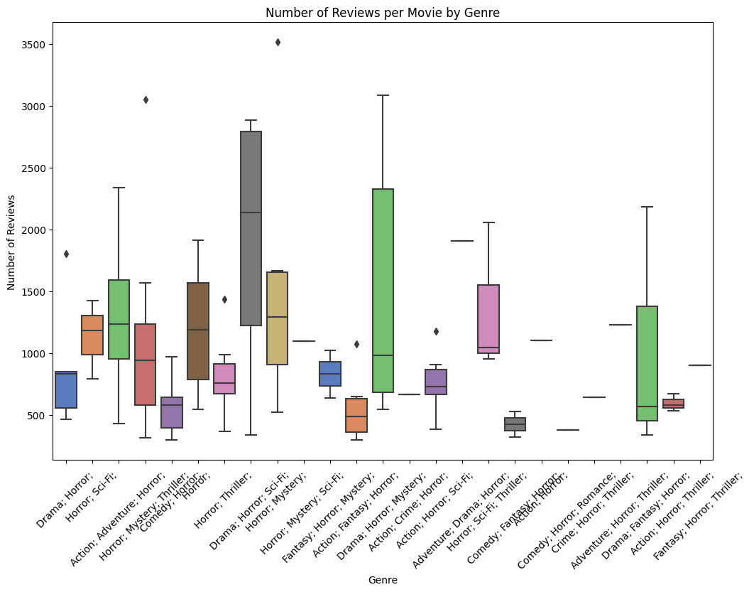
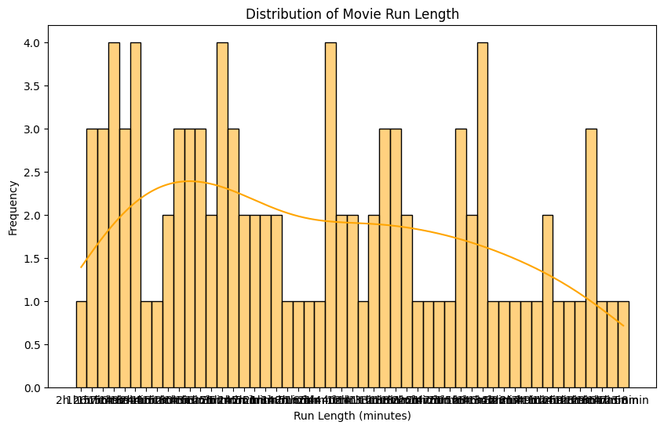
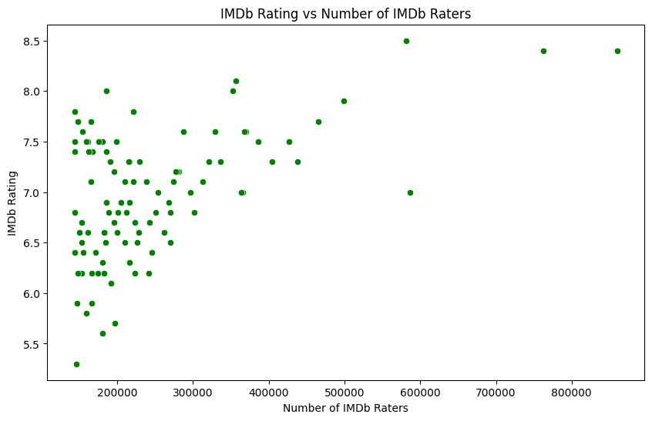
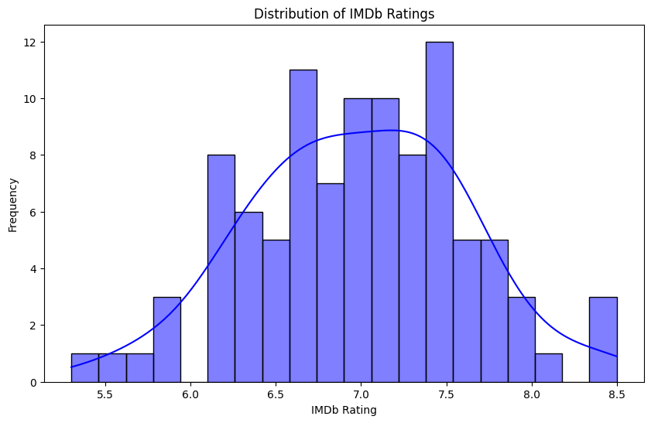
Result

Slide 8
Conclusion
By adopting a system approach, a movie review platform can be developed and managed effectively, addressing the needs of stakeholders while providing users with a seamless and engaging experience for discovering, evaluating, and discussing movies. Through careful planning, design, and execution, the platform can become a valuable resource in the entertainment industry, fostering community engagement and enhancing the movie-watching experience for audiences worldwide.
By adopting a system approach, a movie review platform can be developed and managed effectively, addressing the needs of stakeholders while providing users with a seamless and engaging experience for discovering, evaluating, and discussing movies. Through careful planning, design, and execution, the platform can become a valuable resource in the entertainment industry, fostering community engagement and enhancing the movie-watching experience for audiences worldwide.

Slide 9
Future scope
Advanced Sentiment Analysis:
Utilizing more sophisticated natural language processing (NLP) techniques, including deep learning models, to improve the accuracy of sentiment analysis.
Incorporating emotion detection algorithms to capture the nuanced emotional responses of viewers towards movies.
Personalized Recommendations:
Implementing AI-driven recommendation systems that leverage user behavior data, social interactions, and contextual information to provide highly personalized movie suggestions.
Interactive User Interfaces:
Developing interactive and immersive user interfaces that incorporate augmented reality (AR) or virtual reality (VR) elements to enhance the movie review experience

Slide 10
References
https://www.kaggle.com/code/jaidalmotra/exploring-movie-reviews-dataset
https://youtu.be/GsfT2sv_zCo?si=-pbeOOZ95PiMSR17

Slide 11
THANK YOU

